Slide 1
A core Course on Modeling
Introduction to Modeling
0LAB0 0LBB0 0LCB0 0LDB0
c.w.a.m.v.overveld@tue.nl
v.a.j.borghuis@tue.nl
S.26

Slide 2
Conclude phase: interpret result
define
formulate
purpose
conceptualize
identify
entities
choose
relations
formalize
obtain
values
formalize
relations
execute
operate
model
obtain
result
conclude
present
result
interpret
result
Notes:
2

Slide 3
Reflection: interpret result
define
formulate
purpose
Right problem?
(problem validation)
conceptualize
identify
entities
choose
relations
Right concepts?
(concepts validation)
formalize
obtain
values
formalize
relations
Right model?
(model verification)
execute
operate
model
obtain
result
Right outcome?
(outcome verification)
Right answer?
(answer verification)
conclude
present
result
interpret
result
Notes:
3

Slide 4
When can we have confidence in a model?
confidence assessible when
modeled system
model
modeling purpose
are all known
modeled
system
model
represented by
needs
needs
confidence
with respect to
should fulfill
needs
purpose
Notes:
4

Slide 5
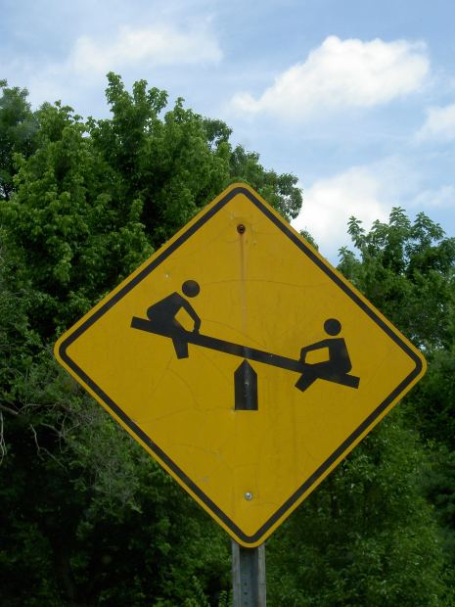
When can we have confidence in a model?
example 1:
elegant and simple model (elementary secondary school physics, say mechanics of levers and slides)
modeled system: not explicitly defined
purpose: to pass one’s exam
http://cdn.morguefile.com/imageData/public/files/j/jdurham/preview/fldr_2009_06_28/file1411246216476.jpg
Notes:
5

Slide 6
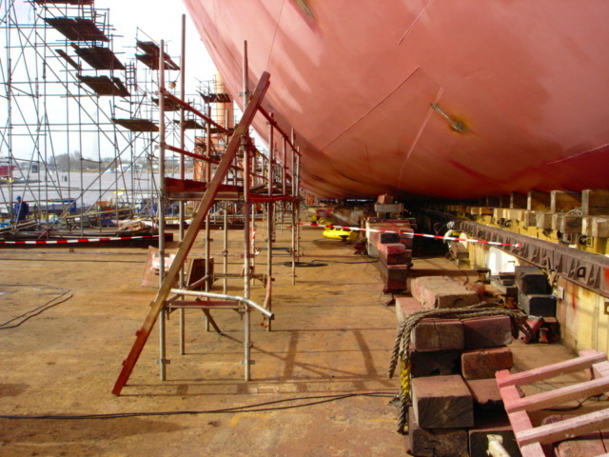
When can we have confidence in a model?
example 1:
elegant and simple model (elementary secondary school physics, say mechanics of levers and slides)
modeled system: ship yard
purpose: to secure safe launch
http://commons.wikimedia.org/wiki/File:Nordseewerke-Stapelllauf-Frisia-Br%C3%BCssel-Helling.JPG
Notes:
6

Slide 7
When can we have confidence in a model?
example 1:
elegant and simple model (elementary secondary school physics, say mechanics of levers and slides)
modeled system: ship yard
purpose: to find direction of moving ship (uphill or downhill?)
http://commons.wikimedia.org/wiki/File:Nordseewerke-Stapelllauf-Frisia-Br%C3%BCssel-Helling.JPG
Notes:
7

Slide 8
When can we have confidence in a model?
example 2:
model: full event log
modeled system: Internet traffic
purpose: diagnose performance bottlenecks
http://cdn.morguefile.com/imageData/public/files/m/matthewhull/preview/fldr_2008_11_28/file0001019265291.jpg
Notes:
8

Slide 9
When can we have confidence in a model?
example 2:
model: full event log
modeled system: Internet traffic
purpose: document for archiving
http://cdn.morguefile.com/imageData/public/files/p/ppdigital/preview/fldr_2005_01_08/file0001384040598.jpg
Notes:
9

Slide 10
When can we have confidence in a model?
example 2:
model: aggregated data
modeled system: Internet traffic
purpose: document for archiving
http://cdn.morguefile.com/imageData/public/files/p/ppdigital/preview/fldr_2005_01_08/file0001384040598.jpg
Notes:
10

Slide 11
When can we have confidence in a model?
example 2:
model: aggregated data
modeled system: Internet traffic
purpose: analyse performance bottlenecks
http://cdn.morguefile.com/imageData/public/files/m/matthewhull/preview/fldr_2008_11_28/file0001019265291.jpg
Notes:
11

Slide 12
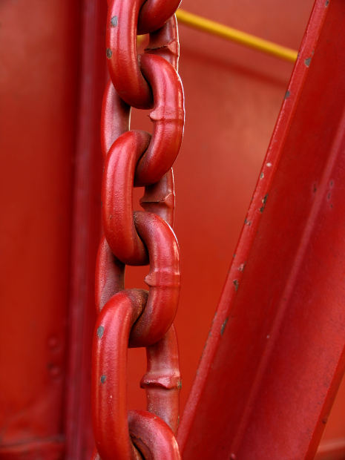
Confidence requires validation and verification
Validation: is it the right model?
consistency model - modeled system
e.g. are cat.-III values correct?
does the model behave intuitively?
consistency model - purpose
e.g. are cat.-II values conclusive?
http://cdn.morguefile.com/imageData/public/files/a/anitapatterson/preview/fldr_2004_09_03/file0001817225686.jpg
Notes:
12

Slide 13
Confidence requires validation and verification
Validation: is it the right model?
consistency model - modeled system
e.g. are cat.-III values correct?
does the model behave intuitively?
consistency model - purpose
e.g. are cat.-II values conclusive?
http://cdn.morguefile.com/imageData/public/files/c/chelle/preview/fldr_2008_11_08/file000910851312.jpg
Verification: is the model right?
consistency conceptual - formal model
e.g. are dimensions correct?
is the graph a-cyclic?
are values within admitted bounds cf. types?
Notes:
13

Slide 14
Confidence requires validation and verification
Validation: is it the right model?
consistency model - modeled system
e.g. are cat.-III values correct?
does the model behave intuitively?
consistency model - purpose
e.g. are cat.-II values conclusive?
modeled
system
model
conceptual &
represented by
formal
needs
needs
confidence
with respect to
should fulfill
needs
Verification: is the model right?
consistency conceptual - formal model
e.g. are dimensions correct?
is the graph a-cyclic?
are values within admitted bounds cf. types?
purpose
Notes:
14

Slide 15
Confidence requires validation and verification
Validation
Verification
accuracy
precision
… based on
Notes:
15

Slide 16
Confidence requires validation and verification
QUIZ
‘Accuracy’ and ‘precision’ seem related, although not identical.
What is the difference between accuracy and precision?
accuracy
precision
Notes:
16

Slide 17
Confidence requires validation and verification
high accuracy low precision
low accuracy high precision
low bias (offset, systematic error), large spreading
a single result gives no information: look at ensembles
low spreading (noise, randomness), large bias
accuracy
precision
low accuracy low precision
high accuracy high precision
large spreading, large bias
low spreading, low bias
Notes:
17

Slide 18
Confidence requires validation and verification
QUIZ
How do you know if a measurement value is an outlier?
high accuracy low precision
low accuracy high precision
accuracy
precision
low accuracy low precision
high accuracy high precision
outlier (freak accident, miracle, …)
Notes:
18

Slide 19
Confidence requires validation and verification
…accuracy can only be assessed with ground truth
…assessment of precision needs no ground truth (reproducibility)
?
?
high accuracy low precision
low accuracy high precision
?
?
accuracy
precision
low accuracy low precision
high accuracy high precision
Notes:
19

Slide 20
Summary:
we need model, modeled system and purpose to asses confidence
validation: is it the right model?
verification: is the model right?
validation requires assessment of accuracy and precision
Notes:
20

